Slide 1
DATABASE MANAGEMENT SYSTEM
UNDER THE GUIDENCE OF:
SUMITH HAZRA

Slide 2
LEAVE MANAGEMENT SYSTEM

Slide 3
TEAM MEMBERS:
2110030054
VAISHNAVI
2110030203
MANISRI
2110030218
NAVYA
2110030233
RISHIKA

Slide 4
DATA SET COLLECTIONS
A data structure is specialized format for organising, processing, retriving and storing the data.
There are several basic and advanced types of data structures, all designed to arrange data for a use of purpose.
Key features:
Employee self-service portal
Multiple clock in/out options including mobile and desktop
GPS tracking to verify employee hours

Slide 5
Tools required :
In this project as a part of DBMS, We need to access data using queries .
DBMS is completely backend software, That is used to retrive or update the data.
We use My SQL for queries .

Slide 6
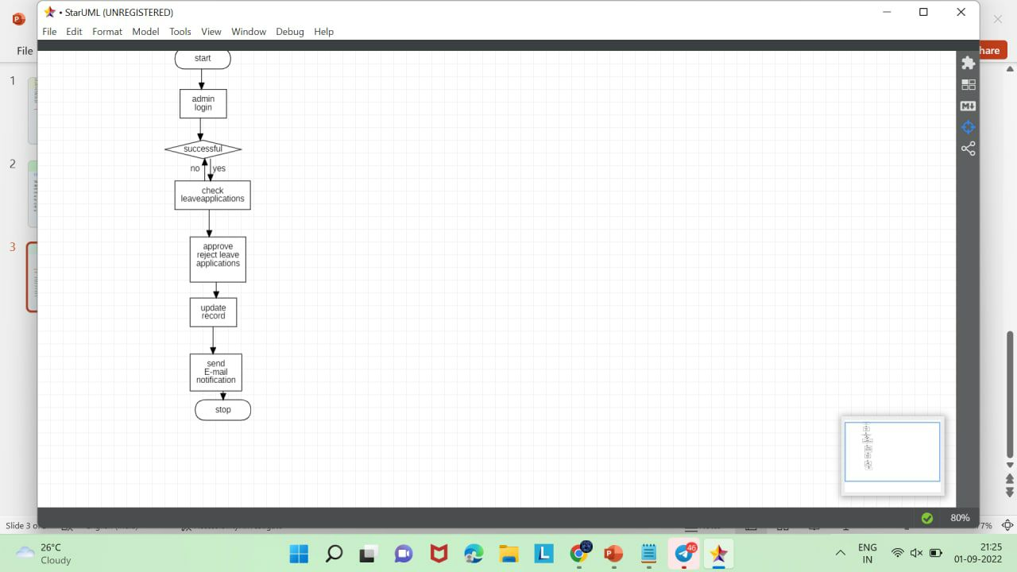
FLOW CHART:

Slide 7
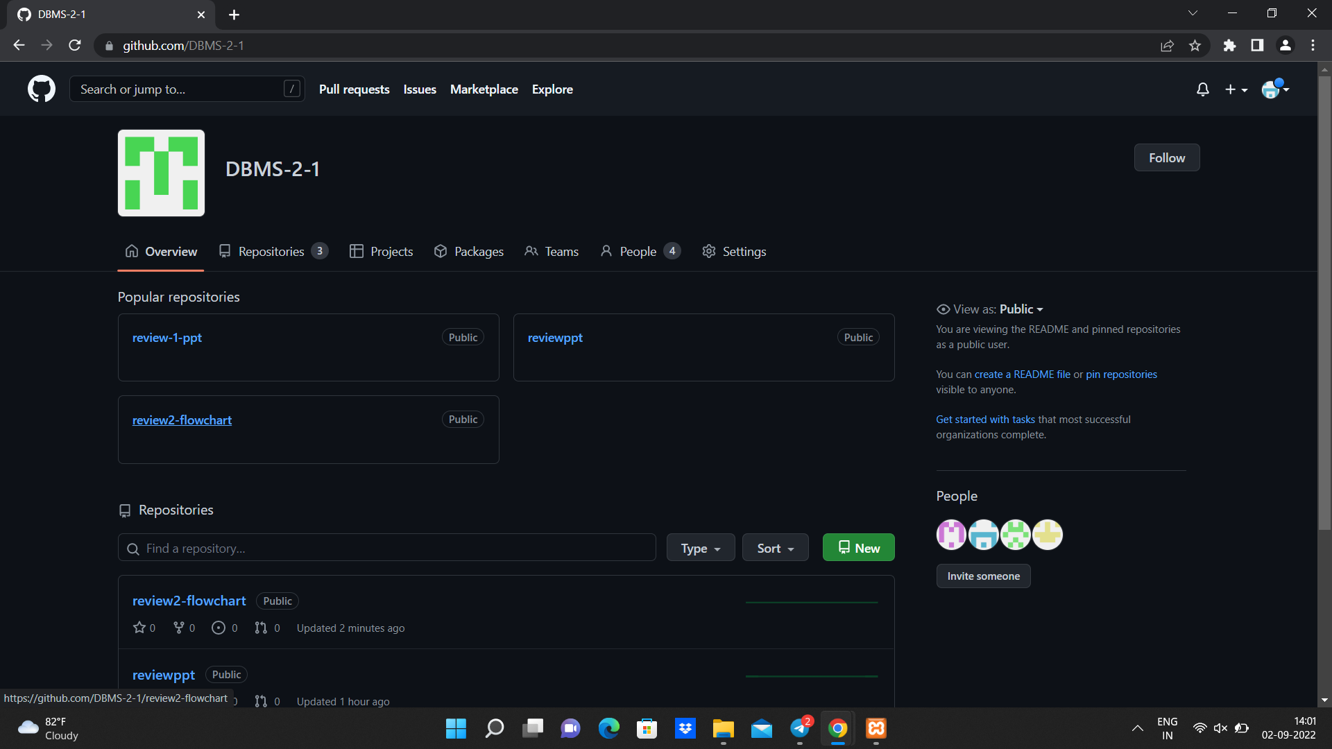
GITHUB COMMITS:

Slide 8
WORK PROGRESS:
To implement the project we need to undergo five phases:
Communication
Planning
Modelling
Construction
Deployment
We completed modelling phase and proceeding to construction phase.

Slide 9
Thank You

